Slide 1
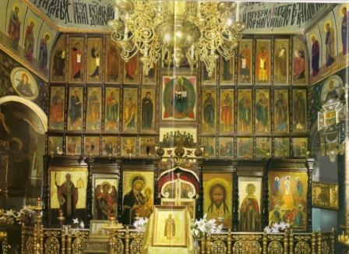
THE ICON SCREEN – ICONOSTASIS OR TEMPLON

Slide 2
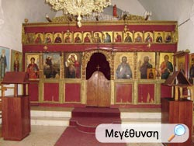
THE ICON SCREEN
It is the partition which separates the sanctuary from the nave.
It is called iconostasis because it is decorated with icons or sacred images

Slide 3
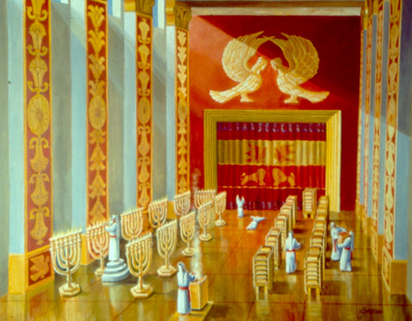
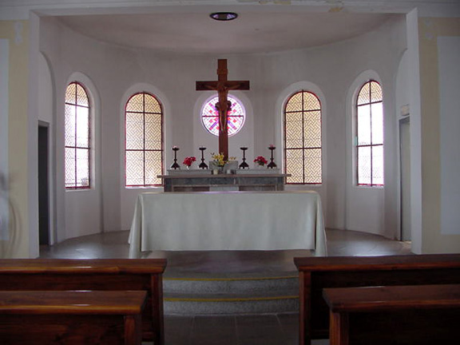
THE ICON SCREEN
It reminds us the curtain of Solomon’s Temple which separated the sanctuary from the rest of the temple.
Roman Catholic and Protestant churches do not have this partition

Slide 4
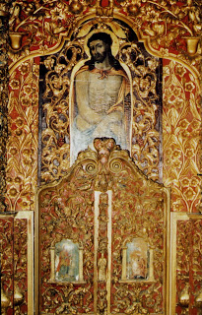
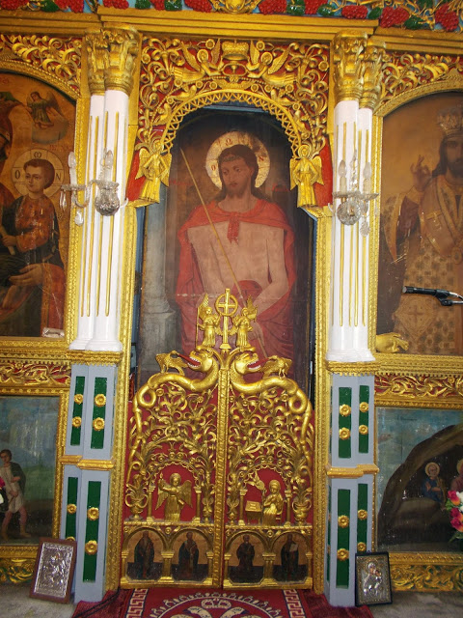
HOLY GATE
The iconostasis has three doors by which the sanctuary communicates with the nave
The central one is the largest and most beautiful
It is called the “Holy Gate” or “Royal Gate”
It is to be used only by clergymen when they are performing church services

Slide 5
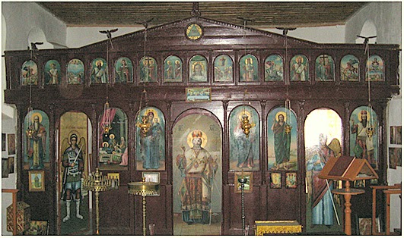
SIDE DOORS OF THE ICONOSTASIS
The other two doors are smaller and are located to the right and left of the middle door, at the far ends of the iconostasis
The door on the left side is called the “northern door”, and the other on the right the ‘southern door’
These side doors are used by the altar boys, the deacons and the clergy

Slide 6
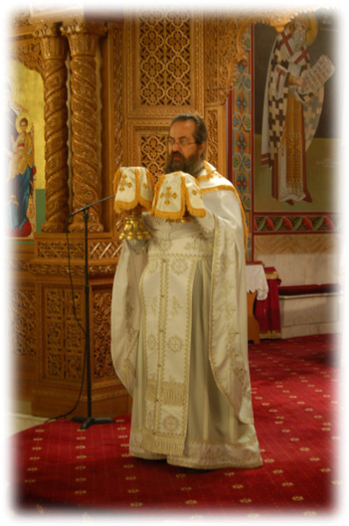
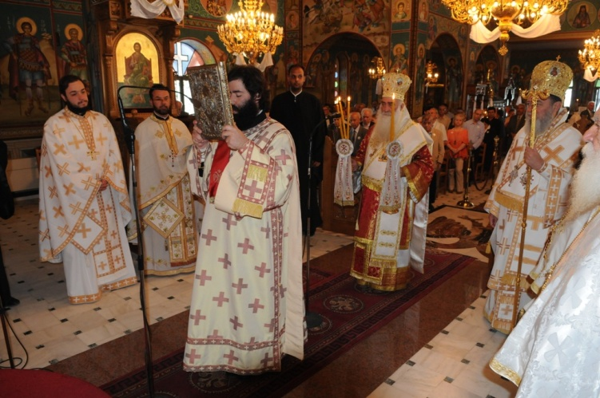
SIDE DOORS OF THE ICONOSTASIS
The northern door is used by the officiating priests during the ‘small introit’ when they exit with the Gospel, and during the ‘great introit’ when they exit with the Holy Gifts
They enter the sanctuary through the Holy Gate because the “King of Glory”, Jesus Christ, passes through it during the Holy Liturgy

Slide 7
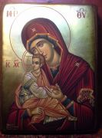
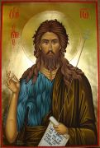
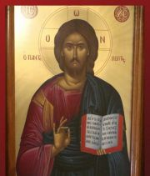
ICONS – LOWER PART
The icons of Christ and St. John the Baptist are on the right side and the icons of the Virgin Mary and the patron Saint of the church on the left
These four icons will be found in every Orthodox church
If there is space on the iconostasis, additional icons may be added

Slide 8
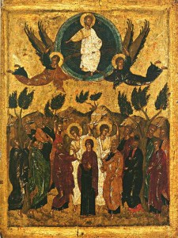
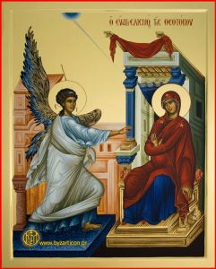
ICONS- UPPER PART
Aside from the large icons on the lower section of the iconostasis, there is also a row of smaller icons, on the upper part
They portray the main events in the life of the Virgin Mary and the life, the passion and the resurrection of Christ
These icons begin with the birth or the Annunciation of the Virgin and end with the Ascension of Christ or Pentecost

Slide 9
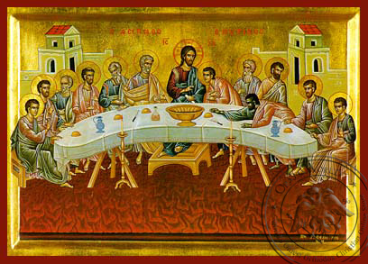
ICONS- UPPER PART
As a rule the center of this row, over the Royal Gate, there is an icon of the Last Supper of the Lord
It is larger and more beautiful than the others and serves as a reminder to the worshippers that the sacrament of the Eucharist is a re-enactment of this great sacred event in the life of our Savior

Slide 10
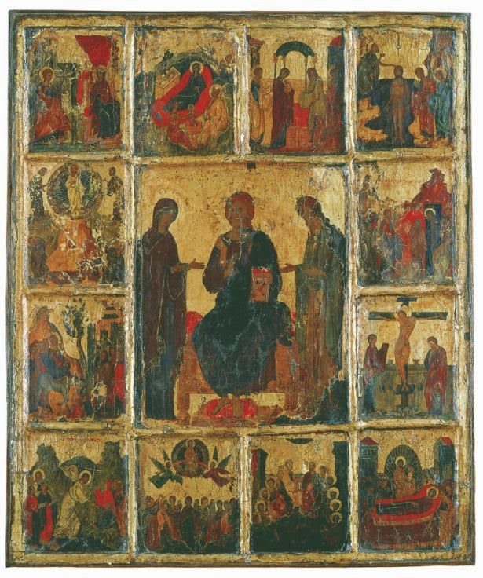
EORTOLOGION OR DODECAERTON
The row of smaller icons is called “Eortologion” or “Dodecaerton” because the icons of this row depict the great twelve feast days of our Church
In some churches there is a second row with icons of the Twelve Apostles

Slide 11
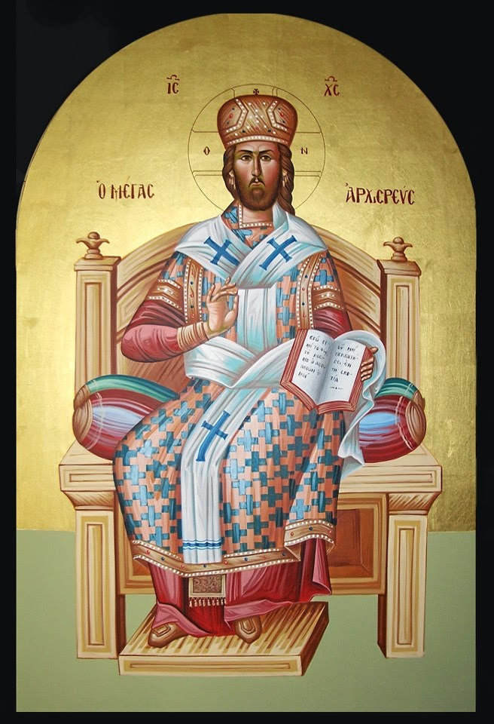
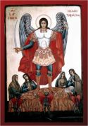
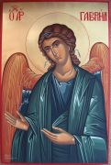
ICONS ON THE THREE DOORS
On the Holy Gate there is the icon of Christ as High Priest
On the northern and southern doors are paintings representing the Archangels Michael and Gabriel
These three figures have allegoric meanings

Slide 12
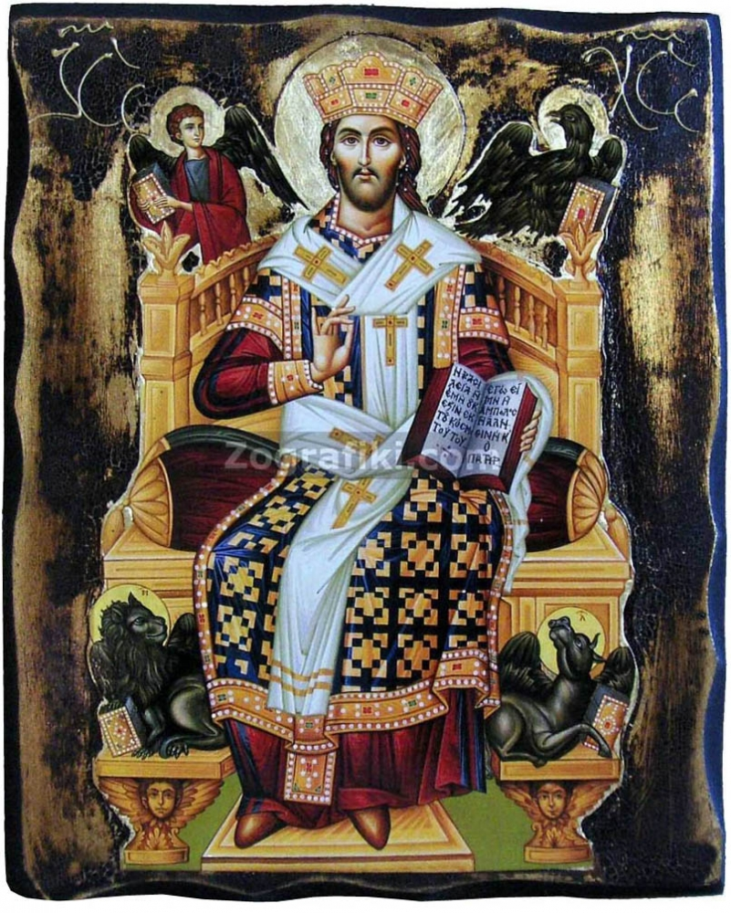
ICON – HOLY GATE
The first figure, Christ as a High Priest, is to remind us that Jesus Christ is the highest of the priests, the one that offered Himself as sacrifice for the salvation of men

Slide 13
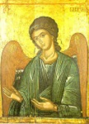
ICONS – SOUTHERN & NORTHERN DOORS
The other two figures of the Archangels symbolize the good spirits which minister unto Him in the Kingdom of Heaven and are the vigilant guards of His Sanctuary

Slide 14
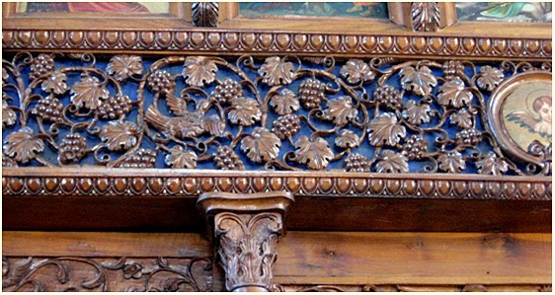
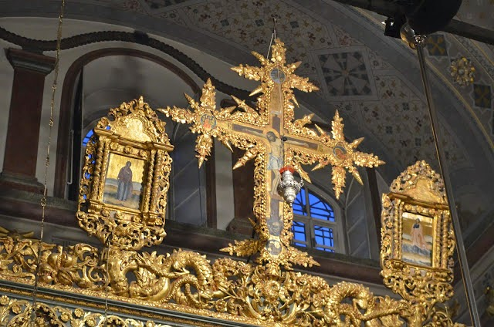
SYMBOLIC ADORNMENTS
On some iconostases there are symbolic adornments
vine branches to remind us of Christ’s saying “I am the vine, ye the branches”
The eye of God within a radiating triangle symbolizing that God sees and knows everything
Other symbols are
Alpha and Omega
The very top is adorned with the cross, the emblem of the Christian faith

Slide 15
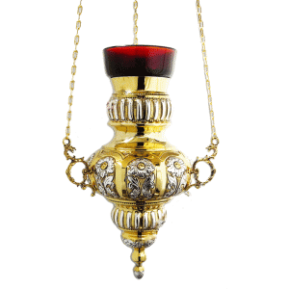
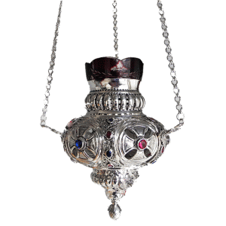
OIL CANDLES
The oil candles hang in front of the sacred images of, illuminating them with their light
Often, larger oil candles hang in front of the icon of the Lord’s Last Supper above the Holy Gate, above the altar in the sanctuary, over the icon stand

Slide 16
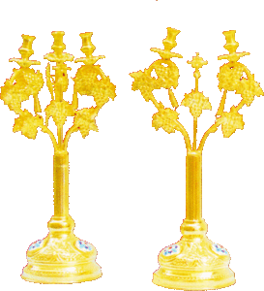
OIL CANDLES
In addition to the small oil candles with one light, there are larger ones with three, seven or thirteen lights
Those with three lights symbolize the Holy Trinity
Those with seven lights the seven sacraments of our Church
And those with thirteen lights the Lord and the Twelve Apostles

Slide 17
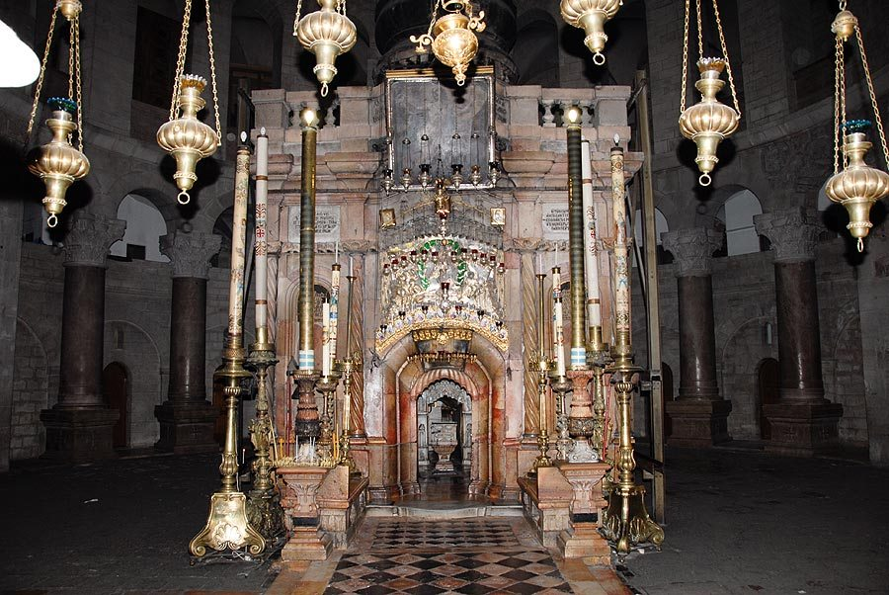
OIL CANDLES
These oil candles usually burn with olive oil which was used extensively in olden times as a means of lighting
Oil was also used for soothing the pain from wounds and as a symbol of divine grace on persons who were chosen kings or high priests by pouring it on their heads
It symbolizes the grace and mercy of God and the peace of soul and our readiness to offer deeds of mercy as sacrifice to the merciful Lord

Slide 18
VOCABULARY I EXERCISE
Find words with the same meaning in the text.
  a wall or screen that separates one part of a room from another______
  is connected with ________________________
  Holy Table, The Communion table ________________
  minister of third order, below bishop and priest______________
  a psalm or antiphon sung or said while a priest approaches the altar
  unoccupied area __________________
  extra, supplementary __________________
  depict, show sb in a picture ______________
  solemn religious ceremony in the Christian church ________________
  a person who saves others from harm or danger _________________
  religious anniversary or festival ____________________
  the offering of something precious to a god _________________
  soul, immaterial, intellectual or moral part of a man ________________
  watchful, on the look-out for danger of any kind ________________
  ornament, decoration ____________________

Slide 19
VOCABULARY II EXERCISE
Use the following words to fill in the gaps
radiated, emblem, adorned, trinity, soothe, wounds, sacrifice, merciful
  The old nun was ____________ to the poor travellers and offered them shelter for the night.
  The doctrine of the ______________ teaches the unity of Father, Son, and Holy Spirit as three persons in one Godhead.
  The dove is a(n) ____________ of peace.
  The holy man’s face ______________ the warmth of his soul.
  God’s deeds _____________ the suffering souls.
  Churches are beautifully _______________ for weddings or baptisms.
  He died after receiving two fatal ___________ on his body.
  In ancient times they offered lambs as ______________ to their gods.

Slide 20
VOCABULARY
VOCABULARY- THE ICON SCREEN – ICONOSTASIS OR TEMPLON
Icon screen: (n) wood or stone structure that partially separates the main part of the
Nave from the altar, εικονοστάσι, τέμπλο
Communicate (sth to sb): a) make known, convey sth b) communicate with sth
c) be connected with, γνωστοποιώ, επικοινωνώ, συνδέομαι
με
altar (n): Holy Table or Communion Table, Αγία Τράπεζα, θυσιαστήριο, βωμός

Slide 21
VOCABULARY
deacon (n): minister of third order below bishop and priest, διάκος
officiate (v): perform the duties of an office or position, (of a priest) perform the
ceremony, εκτελώ χρέη, καθήκοντα, ιερουργώ
Holy Gate: Ωραία Πύλη
Holy Liturgy: Θεία Λειτουργία

Slide 22
VOCABULARY
Additional (adj.): extra, supplementary, συμπληρωματικός, επιπρόσθετος
Row (n): line, σειρά
Portray (v): depict, describe, περιγράφω
Passion (n): the suffering and death of Jesus, τα πάθη του Κυρίου
Resurrection (n): the rising of Jesus from the tomb, Ανάσταση
Annunciation (n): the announcement of the fact that the son of God was to
be born of the Virgin Mary, Ευαγγελισμός, Χαιρετισμός

Slide 23
VOCABULARY
Ascension (n): Jesus left the earth and went to heaven, Ανάληψη
Eucharist (n): celebration of ‘thanksgiving” by Christians and more specifically
The consecrated bread and wine, Holy communion, cup of blessing,
Table of Christ, Ευχαριστία, Θεία Κοινωνία
Re-enactment (n): the performance of a play or part of it, παράσταση, αναπαράσταση

Slide 24
VOCABULARY
Allegoric (adj.): αλληγορικός
High priest: Aρχιερέας
Minister (v): serve, give help or service, υπηρετώ, φροντίζω, προσφέρω, παρέχω
Vigilant (adj.): watchful, on the look-out for danger of any kind, άγρυπνος,
προσεκτικός

Slide 25
VOCABULARY
Guard (n): φύλακας
Vine (n): άμπελος
Adornment (n): ornament, decoration, κόσμημα, διακόσμηση
Radiate (v): send out light or heat, ακτινοβολώ
Emblem(n): symbol, έμβλημα
Holy Trinity: The Union of Father, son and the Holy Spirit, Αγία Τριάδα
Soothe (v): make (pain) less severe or painful, calm down, απαλύνω, ηρεμώ
Mercy (n): capacity for holding oneself back from punishing or causing suffering
to, οίκτος

