Slide 1
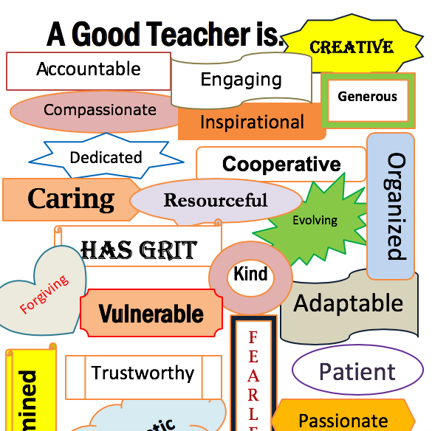
1.10 Applying new speaking skills
What is a good teacher?

Slide 2
OBJECTIVES
Students should be able to:
pronounce words with the sounds /ɪ/, /i:/, /p/ and/b/;
Research and produce a short talk using target vocabulary, language and subskills from the theme.

Slide 3
A. Reviewing sounds (1)
1. Study the dialogues below.
Underline the words with the vowel sound /ɪ/.
(Circle) words with the vowel sound /i:/.
1. A: How do you feel?
B: I'm really ill.
2. A: Did you eat the eel?
B: No, I didn’t!
3. A: Is he his brother?
B: No, but she’s his sister.
2. Practise the dialogue in pairs.

Slide 4
ANSWERS
CIRCLE:
Feel, really, eat, eel, he, she’s
UNDERLINE:
ill, did, didn’t, his, his sister

Slide 5
B. Reviewing sounds (2)
Say each pair of words below. Make sure your partner can hear the difference.
 | A | Β
1. | bit | pit
2. | buy | pie
3. | bought | port
4. | open | Oban
5. | cab | cap

Slide 6
C. Researching information
Work in two groups.
Group A: Read the text on the good teacher.
Group B: Read the text on the bad teacher.
Underline the new words.
Ask the other members of your group about the new words.
Complete the correct part of Table 1.
Add any ideas of your own to your column.

Slide 7
GROUP A
WHAT IS A GOOD TEACHER?
Research shows that children have very clear ideas about teachers. Good teachers keep order in the classroom. This means they stop bad behaviour. Good teachers explain things clearly. They show enthusiasm for their subject. In other words, they like their subject and they are excited about teaching it. Good teachers treat the children as individuals. This means they know the names of all their students and they know personal facts about each one. Finally, good teachers have a good sense of humour and make jokes.

Slide 8
GROUP B
Research shows that children have very clear ideas about teachers. Bad teachers are not interested in their subject. They are sarcastic. In other words, they make fun of children, their work or their ideas. Bad teachers belittle children. To belittle means to make them feel small. Finally, bad teachers are unfair. They give rewards, or good things, to the wrong children. They give punishments, or bad things to the wrong children, too.

Slide 9
TABLE 1: GOOD AND BAD TEACHERS
good | bad
keep order (= stop bad behaviour) | sarcastic (= make fun of)

Slide 10
ANSWERS
GOOD TEACHER
BAD TEACHER
Keep order
(= stop bad behaviour)
Explain clearly
Show enthusiasm (= like subject, excited about teaching)
Treat children as individuals (know names, personal facts)
Sense of humour (make jokes)
Other ideas
Eye contact
Patient
Mark work and return it quickly
Sarcastic (= make fun of)
Belittle children
(= make them feel small)
Unfair (= reward wrong children)
Give punishments
(= bad things, wrong children)
Other ideas
Angry, shout
Don’t return work
Don’t explain

Slide 11
D. Giving a short factual talk
Stay in two groups, A and B.
Read Assignment 1. Which talk are you going to give?
Prepare your talk. Remember:
Choose the correct tense for each section.
Form the tense correctly.
Give definitions of new words.
Underline key words and phrases in your talk.
3. Practise giving your talk to your group.
4. Make new groups. There must be students from Group A and Group
Β in each group. Give your talk.
5. Ask about any new words.

Slide 12
ASSIGNMENT 1
Faculty of Education - Assignment 1
Reflect on your experiences of being a student.
In the next tutorial you must give a short talk.
Either:
- give your idea of good teachers and talk about the best teacher you ever had.
Or:
- give your idea of bad teachers and talk about the worst teacher you ever had.

