Slide 1
SAINT SPYRIDON

Slide 2
ST. SPYRIDON – EARLY LIFE
He was from Trimythous, Cyprus
He was a shepherd
He was widowed
He was ordained a bishop in short order
Although uneducated, his humility, modesty and great dedication to his work made him a perceptive, astute and sage man

Slide 3
ST. SPYRIDON – LIFE FACTS
Before Christians were granted religious freedom in 313 persecutions of Christians were common
Spyridon himself was imprisoned and sent to a labor camp for 8 harsh years

Slide 4
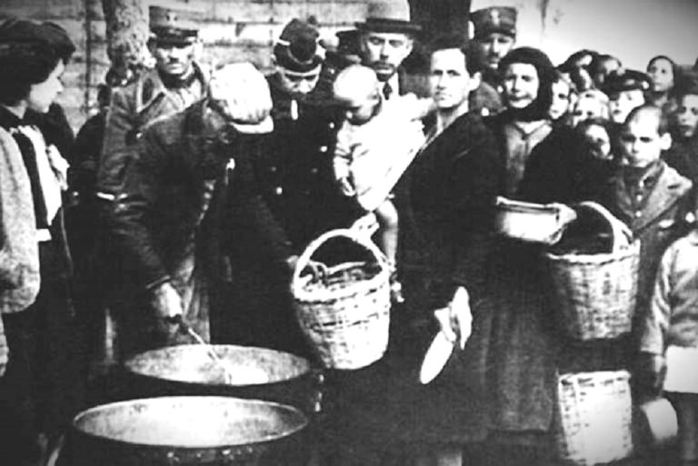
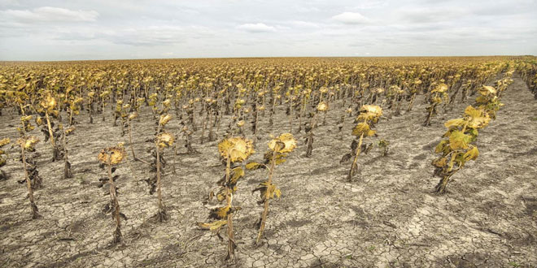
THE MIRACLE WORKER
Spyridon performed numerous miracles in his lifetime
He cured people of their illnesses
He provided food in times of famine, rain in times of drought
He ministered to the poor and needy

Slide 5
THE MIRACLE WORKER
The Saint also resurrected a young girl and her mother from the dead
Anyone who tried to rob or cheat Spyridon was immediately punished by the Holy Spirit

Slide 6
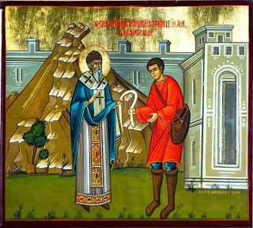
THE MIRACLE WORKER
Once a group of men tried to steal his livestock one night but were paralyzed on the spot
Spyridon found them the next morning and forgave them

Slide 7
THE MIRACLE WORKER
Once he was rushing to town to help a friend who was wrongly accused of a crime
The local river had flooded and he could not pass
He prayed for assistance and the river parted and made way for him and others to pass through

Slide 8
THE MIRACLE WORKER
Another story tells of when a woman had given Spyridon’s daughter a piece of jewelry for keepsafing
the girl died suddenly without having told anyone the secret hiding place
Spyridon prayed at his daughter’s gravesite and asked her where the jewel was and the daughter answered him

Slide 9
FIRST ECUMENICAL SYNOD
Spyridon attended the first Ecumenical Synod in Nicaea in 325 A.D.
A synod is a formal meeting of bishops and representatives of the church to take important decisions on the doctrine and life of the Church

Slide 10
FIRST ECUMENICAL SYNOD
St. Nicholas of Myra was also present in the at this first Synod
The Council meeting was greatly concerned with a debate over the true nature of Christ and the relationship among the Holy Trinity
Arios, a clever scholar, was in support of a view that many thought to be heretical

Slide 11
FIRST ECUMENICAL SYNOD
Arios’s argument was quite convincing as he was an articulate and persuasive speaker
Spyridon, the uneducated country man, chose to speak and explained to Arios and the Council the true nature of the Holy Trinity

Slide 12
FIRST ECUMENICAL SYNOD
All three are of the one substance with God, the Father
He demonstrated his idea by holding a piece of clay tile
He first said “In the name of the Father” and the clay burst into flames
Then “And the Son” and water flowed from the clay
“And the Holy Spirit”, and in his hand there remained only dirt

Slide 13
FIRST ECUMENICAL SYNOD
The three properties of the spirit-fire, water and earth showed themselves to be of one essence
Arios’s war of words was over and he repented his heresy and accepted the will of God

Slide 14
CORFU
Spyridon’s holy body has remained whole and intact since he passed away
He was buried in Cyprus until the 7th century when his relics were brought to Constantinople
When the city was invaded by the Turks in 1453, a priest escaped from the city with the sacred relics and brought first to Epirus and then to the island of Corfu in 1456

Slide 15
CORFU
Throughout the centuries the Miracleworker has protected the island from barbaric invasions, plagues and epidemics
A cathedral was built in his honor and St. Spyridon’s relics lie there today

Slide 16
THE SHEPERD
Spyridon was a simple man of modest lifestyle
He felt a true responsibility for his spiritual children
Social injustice grieved him as did humankind’s obsession with money and material possessions

Slide 17
THE SHEPERD
He was constantly in prayer to God for guidance and in preparation for any task
He had the gift of foreseeing and knowing people’s hearts
He tended to his livestock until the day he foresaw his own death on December 12, 348 A. D.

Slide 18
READING COMPREHENSION
Where was Spyridon from?
Was he ever imprisoned?
How did he help people? Give examples
What is a synod?
Did he attend the first Ecumenical Synod? Who else attended that Synod?
How did he demonstrate and prove the nature of the Holy Trinity?
Where was he buried?
How were his relics found in Corfu?
When did he die?

Slide 19
VOCABULARY I
Find words in the text with the following meanings:
reverence for God _____________________
famous________________________
clever, cunning ____________________
wise, judicious ______________________
offer, give ______________________
grim, unpleasantly severe _________________________
show by example _____________________
extreme scarcity of food, hunger _______________________
period of dry weather ________________________
deceive ______________________
all animals kept on a farm ______________________
move with speed ________________________
of a particular place _______________________
to overflow with water ______________________
place someone is buried ____________________

Slide 20
VOCABULARY II
Match the words with their definitions
ecumenical ____ a. πειστικός
doctrine ____ b. εμμονή
debate ____ c. οικουμενικός
argument ____ d. ανέπαφος
articulate ____ e. δουλειά
persuasive ____ f. ουσία
substance ____ g. καθοδήγηση
will ____ h. σαφής, εύγλωττος
intact ____ i. δόγμα
invade ____ j. θλίβομαι
plague ____ k. επιχείρημα
grieve ____ l. θέληση
obsession ____ m. διαμάχη
guidance ____ n. μάστιγα
task ____ o. εισβάλλω

Slide 21
VOCABULARY III
Use the word in bold in the correct form
Before religious freedom, _________ of Christians were common PERSECUTE
Spyridon cured people from their ________ ILL
He prayed for ________ and God helped him ASSIST
Although __________, Spyridon proved in the synod the true nature of the Holy Trinity EDUCATE
Arios was an articulate and __________ speaker PERSUADE
Spyridon felt true _____________ for his spiritual children RESPONSIBLE
He was constantly in prayer to God for _________ GUIDE
He protected Corfu from barbaric __________ INVADE

Slide 22
VOCABULARY
Piety (n.) : reverence for God, quality of being pious, ευσέβεια
Renowned (adj.) : famous, celebrated, διάσημος, ξακουστός
Perceptive (adj.) : having or showing understanding, οξύνους, έξυπνος, ικανός να
καταλάβει
Astute (adj.): clever, cunning, shrewd, of keen penetration, οξύνους, έξυπνος
Sage (adj.) (n.) : wise, judicious, σοφός
Grant (v.) : offer, give, χορηγώ, δίνω, παρέχω
Harsh (adj.): grim, unpleasantly severe, τραχύς, δριμύς, ανάλγητος
Exemplify (v.) : to show or illustrate by example, παραθέτω παράδειγμα
Famine (n.): extreme scarcity of food, extreme hunger, starvation, λιμός
Drought (n.) : period of dry weather, ξηρασία
Cheat (v.) : to deceive, εξαπατώ, κάνω ζαβολιά, κλέβω (στα χαρτιά κλπ.)
Livestock (n.) : all animals kept on a farm, εκτρεφόμενα ζώα, ζωντανά
Rush (v.) : dash, move with speed, σπεύδω, ορμώ

Slide 23
VOCABULARY
Local (adj.) : of a particular place, ντόπιος, τοπικός
Flood (v) : to overflow with water, πλημμυρίζω (n.) πλημμύρα
Make way for (phr. v.) : παραμερίζω για, κάνω τόπο για
Ecumenical (adj.) : general, universal, οικουμενικός
Doctrine (n.) : particular principle, position, system or body of teaching relating
to a particular subject, δόγμα
Argument (n) : process of reasoning, επιχείρημα , διαφωνία
Debate (n) : discussion of a public question involving opposing viewpoints, διαμάχη
Scholar (n) : one with profound knowledge of a particular subject, πολυμαθής,
φιλόλογος, υπότροφος
Articulate (adj.) : using language clearly and easily, σαφής, κατανοητός
Will (n.) : wish, desire, θέλημα

Slide 24
VOCABULARY
Substance (n.) : that of which a thing consists, ουσία, ύλη
Burst into (v.) break out into sudden activity, ξεσπώ
Essence (n) : the basic, real nature of a thing, ουσία
Intact (adj.) : complete, whole, unchanged, ανέπαφος, άθικτος
Invade (v.) : to enter forcefully as an enemy, εισβάλλω, πραγματοποιώ επιδρομή
Invasion (n.) : εισβολή, επιδρομή
Plague (n) : infectious, epidemic, disease, μάστιγα, πανούκλα
Grieve (v) : to feel grief or sorrow, πενθώ, θρηνώ, λυπώ, θλίβομαι,
Obsession (n) : persistent idea, image, desire, εμμονή
Material (n) : ύλη, υλικό
Possession (n) : belonging, απόκτημα, ιδιοκτησία
Task (n) : piece of work, εντεταλμένο έργο, καθήκον, δουλειά
Harvest (v) : to gather the crop, συγκομίζω, (n) θερισμός, συγκομιδή, σοδειά

Slide 25
links
https://youtu.be/YVzn4xcbMUs
https://oca.org/saints/lives/2000/12/12/103526-st-spyridon-the-wonderworker-and-bishop-of-tremithus
https://orthodoxwiki.org/Spyridon_of_Trimythous

