Slide 1
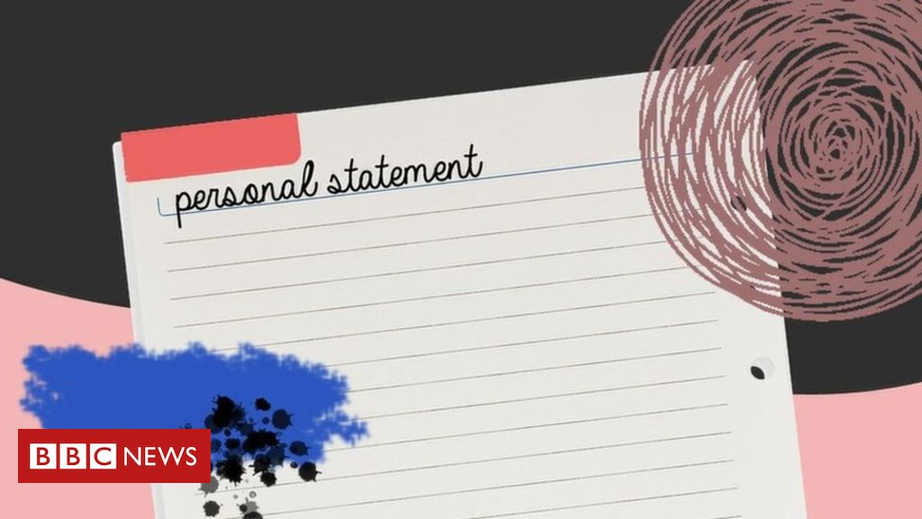
1.18 LEARNING NEW WRITING SKILLS
Paragraphs from a Personal Statement

Slide 2
OBJECTIVES
Students should be able to:
Spell words with the sound /i:/;
Demonstrate understanding of organization of information into paragraphs in a Personal Statement.

Slide 3
Α. DEVELOPING VOCABULARY
All these words from the theme have the same vowel sound.
What is the sound? What is the correct spelling?
1. Write one or two letters in each space.
a. increase f. stud......
b. eight........n g. t..........ch
c. facult........... h. m.........n
d. r................d i. l..........ve
e. d.............tails j. degr..........

Slide 4
SKILLS CHECK 1
2. Read Skills Check 1 and check your answers.
Skills Check 1
Spelling the /i:/ sound
There are five main ways to spell this sound. e me, we, he, details ee green, see, degree, eighteen ea read, teach, mean, leave, easy ie achieve, believe, thief y history, very, study, faculty

Slide 5
ANSWERS
a. increase
b. eighteen
c. faculty
d. read
e. details
f. study
g. teach
h. mean
i. leave
j. degree
3. Write some more words with each pattern, e.g., agree.

Slide 6
B. Identifying a new skill
1. Read Skills Check 2.
Skills Check 2
Organizing information into paragraphs
In English, we put all the information about one subject into the same paragraph. The first paragraph of Olivia's Personal Statement (Lesson 1.17) contains personal details - name, age, nationality, etc. My name is Olivia Amanda Martins and I am eighteen years old. I am British. I was born in London On 15th April, 1992. I live in Lymington on the south coast of England. When you are writing, choose a subject for each paragraph. Then decide the information to go into each paragraph.

Slide 7
Study the list of paragraph topics below.
1. Personal details 5. Qualifications
2. Course + reasons 6. Hobbies and interests
3. Schools in the past 7. Work
4. School now + subjects 8. Conclusion

Slide 8
Read the sentences from a Personal Statement below. Write the number of the correct paragraph next to each sentence.
□ I also participate in a small music group.
□ I am applying for the BA course in Engineering.
□ I am married.
□ I am not studying at school now.
□ I am particularly interested in machines,.
□ I am working full-time as a sales assistant at the moment.
□ I enjoy playing the guitar and writing music.
□ I believe that engineering is the career for me because I like working with machines.
□ I finished school in July 2009.
□ I live in Madrid.
□ I obtained the International Baccalaureate (IB) in 2009.
□ I studied at the American School of Madrid.
□ I want to become an engineer.
□ I scored 38 points in the IB.
□ My name is Pablo Juarez and I am Spanish.
□ In conclusion, I always try hard in my studies.

Slide 9
ANSWERS
6 I also participate in a small music group.
2 I am applying for the BA course in Engineering.
1 I am married.
4 I am not studying at school now.
2 I am particularly interested in machines,.
7 I am working full-time as a sales assistant at the moment.
6 I enjoy playing the guitar and writing music.
8 I believe that engineering is the career for me because I like working with
machines.
4 I finished school in July 2009.
1 I live in Madrid.
5 I obtained the International Baccalaureate (IB) in 2009.
3 I studied at the American School of Madrid.
2 I want to become an engineer.
5 I scored 38 points in the IB.
1 My name is Pablo Juarez and I am Spanish.
8 In conclusion, I always try hard in my studies.

Slide 10
D. PRODUCING KEY PATTERNS
Study the openings of more sentences from the Personal Statement. Complete each sentence with true information about you.
1. I want to study ............................................................................................................................................................................................
2. I hope to get ................................................................................................................................................................................................
3. I am particularly interested in ...............................................................................................................................................................
4. I hope to become ......................................................................................................................................................................................

