Slide 1
1.2 REAL-TIME LISTENING
A SPEECH OF WELCOME

Slide 2
OBJECTIVES
By the end of lesson, students should be able to:
1. demonstrate understanding of a spoken text using target language and skills for the theme;
2. demonstrate understanding of real-world knowledge about key personnel and their roles at universities.

Slide 3
Activating background knowledge
 | Tick the jobs below that you find in a university. What does each person do?
□ | bookseller | □ | cook
□ | car park attendant | □ | gardener
□ | caretaker | □ | lecturer
□ | cleaner | □ | librarian
□ | manager | □ | teacher
□ | nurse | □ | waiter
□ | receptionist | □ | hairdresser
□ | secretary | □ | guard

Slide 4
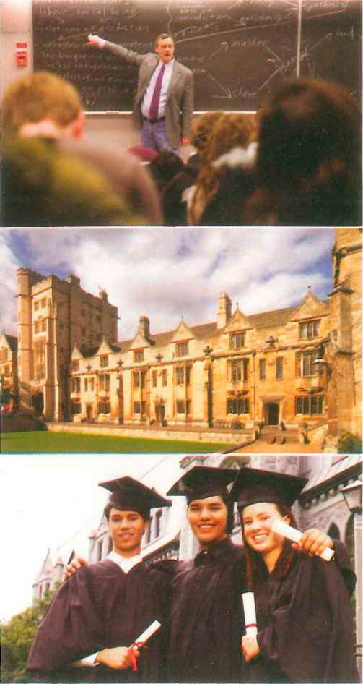
B. Understanding introductions
You are going to watch an introduction to the Faculty
of Education at Greenhill University.
What is Mr. Beech saying? 1.B. Watch the first part of his
talk, with the sound turned right down.
Guess some of his words.
1.B. Listen to the talk now and check your ideas.
What does each person in the faculty do? Write notes
next to the names on the list in the next slide.

Slide 5
GREENHILL UNIVERSITY Faculty of Education
Dean of Education | Peter Beech | responsible for Fac. of Ed.
Bursar | Mrs Pearce
Head of Year 1 | Pat Pinner
Accommodation Manager | Bill Heel
Resource Centre Manager | Ben Hill
Head of ISS | Tim Mills

Slide 6
ANSWERS
Responsible for Faculty of Education
Deals with money
Head of Yr. 1; responsible for schedule
In charge of halls of residence
Helps you find info
Helps international students
Dean of Education | Peter Beech
Bursar | Mrs Pearce
Head of Year 1 | Pat Pinner
Accommodation Manager | Bill Heel
Resource Centre Manager | Ben Hill
Head of ISS | Tim Mills

Slide 7
C. Understanding words in context
You are going to watch a short talk by Mrs. Pinner. She defines several words in her talk. Watch the talk. Tick the correct definitions.
1. | campus | √ | money for a course
2. | resources | □ | Senior Common Room
3. | fees | □ | the university buildings
4. | Welfare Office | □ | accommodation for students on campus
5. | JCR | □ | things to help with studying
6. | SCR | □ | place to go if you have problems with fees
7. | hall of residence | □ | special place for students
8. | Students' Union (SU) | □ | Junior Common Room

Slide 8
Answers
Campus = the university buildings
Resources = things to help with studying
Fees = money for a course
Welfare Office = place to go if you have problems
JCR = Junior Common Room
SCR = Senior Common Room
Hall of residence = accommodation for students on campus
Students’ Union (SU) = special place for students

Slide 9
D. Transferring information
Study the campus map.
1. Which places are mentioned in Mrs. Pinner's talk?
Find and circle them on the map.
2. What can students do in each place?
What does a dean do at a British university? He or she is responsible for a faculty.

Slide 10
THE MAP

Slide 11
Answers
Places to circle:
A, B, C
JCR, SCR
Medical Centre
SU
Admin Block
Welfare Office
Library
Resource Centre

Slide 12
More Answers
Place
Library
Resource Centre
Administration Block
Welfare Office
Medical Centre
JCR,SCR
Halls of residence
SU (Students’ Union)
ISS
What happens?
You can read, do research, find information, study there.
You can use the internet, do research, work on computers, use the printers.
You can go there if you have problem with fees, accommodation, parking permits, etc.
You can go here if you have a personal problem.
You can go here if you are ill.
You can go here if you need to speak to a lecturer.
This is where students live.
There are facilities for students: bar, gym, cafe, clubs, etc.
This is for international students. Go there if you have a problem with your visa.

