Slide 1
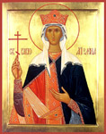
SAINT HELEN

Slide 2
Saint Helen
She was an innkeeper’s daughter who married an ambitious Roman officer. They had a child, a son. Years later, the officer would rise through the ranks of the Roman Empire and take his son to the imperial Court. Later, this husband would divorce her to make a politically advantageous marriage in order to secure his place as Emperor. She, however, lived alone and in obscurity for almost thirty years, until her son became Emperor upon his father’s death, and he proclaimed her Empress.

Slide 3
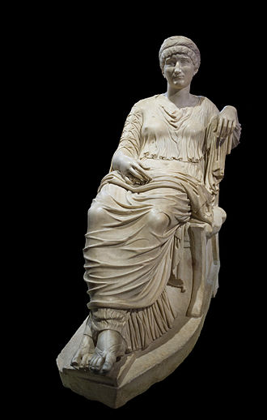
Constantius Chlorus – Saint Helena

Slide 4
Saint Helen
Helen was the mother of Constantine, the first Christian Emperor of the Roman Empire who in 311 A.D. conquered his enemies by a miracle of God and officially recognized Christianity and ended the age of persecution. He made an ancient Byzantine city his new capital, Constantinople.

Slide 5
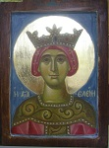
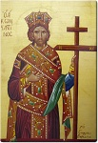
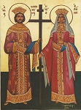
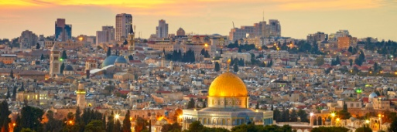
Main points
She was an innkeeper’s daughter
She married an ambitious Roman officer and they had a son
Her husband divorced her to make a politically advantageous marriage
When her son became the Emperor, he proclaimed her Empress
She travelled to the Holy Land to find the site of the Crucifixion

Slide 6
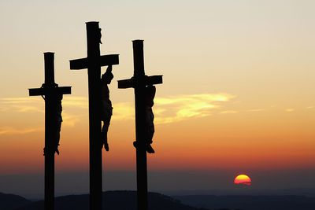
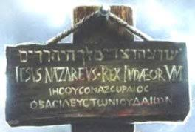
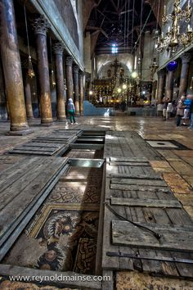
Main points
She found three crosses and a piece of wood with the inscription “Jesus of Nazareth, King of the Jews”
She sent part of the cross and some nails to her son the Emperor back in Constantinople
She built numerous churches in Jerusalem
She died c. 328 A. D.

Slide 7
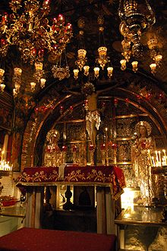
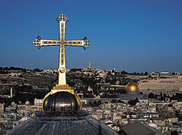
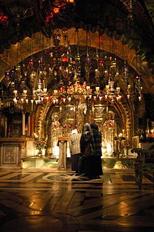
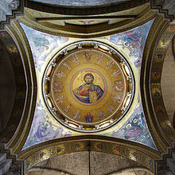
Church of the Holy Sepulchre

Slide 8
SAINT HELEN
Helen was a very dedicated Christian, in 326 she journeyed to the Holy Land to see the places where Christ lived and died. She was by this time in her eighties. Eva Catafygiotou Topping in her book "Saints and Sisterhood" points out that Helen was the first Christian to make this pilgrimage and was also the first Biblical archaeologist.

Slide 9
SAINT HELEN
Helen wanted to find the cross on which Jesus had been crucified. Over three hundred years had past since the Crucifixion, but she was tenacious in her research. She had excavations begun on a site of an ancient temple to Aphrodite where she found the cave where Jesus had been buried. Three crosses were found close by in addition to a piece of wood inscribed "Jesus of Nazareth, King of the Jews" in Hebrew, Greek and Latin, just as noted in the Gospels.

Slide 10
SAINT HELEN
Helen sent part of the Holy Cross to her son (the other part remained in Jerusalem) along with the nails with which Jesus had been fastened to the cross. Constantine put two of these nails in his royal crown. Helen lived in Jerusalem for some time and had over 28 churches built including the Church of the Holy Sepulchre on the site of Christ’s tomb, the Church of the Ascension on the Mount of Olives, the Church of the Nativity in Bethlehem over the grotto where Christ was born, and in Magdala, a church honoring Mary Magdalene.

Slide 11
SAINT HELEN
Helen’s activism, generosity, humility and compassion made her renowned throughout the Empire. When she returned to Constantinople, she brought with her many sacred relics as well as the basil plant which she had found growing at the site of the Cross.

Slide 12
SAINT HELEN
Helen made herself the model for Christian Queens. The Church honors her and her son Constantine as Equal to the Apostles, associating them with the founders of Christianity. Helen died c. 328 A.D. and her son died ten years later on May 21st, the day the Church honors the first Christian Emperor and his co-worker in shaping the Christian Church — a most formidable woman.

Slide 13
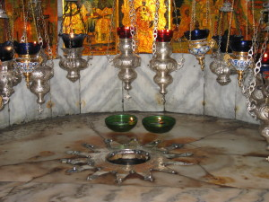
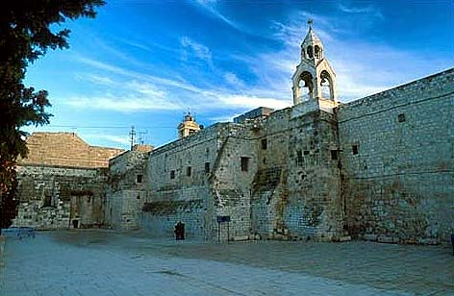
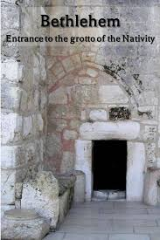
Church of the Nativity

Slide 14
CHAPEL of the Ascension – MOUNT OF OLIVES

Slide 15
Saint Mary of Magdala

Slide 16
Saint Helen - Video

Slide 17
Vocabulary I– exercise 1 MATCHING
innkeeper
Ambitious
Roman
Officer
Rank
Empire
Emperor
Empress
Imperial
Court
Divorce
advantageous
of an empire
Official residence of a sovereign
Female ruler of an empire
Grade or position in the army
Legal ending of a marriage
Owner of an inn
Person appointed to command others
Full of strong desire to achieve sth
Profitable, beneficial
Ruler of an empire
Group o countries under the same ruler
Of ancient Rome

Slide 18
VOCABULARY II – EXERCISE 2
Find words in the text with the following meanings:
Devoted, committed
Make known officially
Welcomed act caused by supernatural power
Take possession of sth by force
Killing by nailing or tying on a cross
Activity of digging
Write on
Respect highly
Persistent
Pity for the suffering of others
Famous, celebrated
Holy dead body or remains of a person
Inspiring awe and respect because of excellence or strength

Slide 19
VOCABULARY III – EXERCISE 3
Put the words into the correct form in the gaps.
Helen was a very __________ Christian DEDICATE
Their _____________ lasted for fifty years. MARRY
Saint Helen lived in _______________ for thirty years. OBSCURE
The Byzantine ___________ lived in Constantinople EMPIRE
After His ____________ Jesus visited the Apostles. CRUCIFY
Helen was renowned for her ______________. GENEROUS
The _____________ of our Church are the Apostles. FOUND
Constantine the Great officially recognized _________ CHRISTIAN

Slide 20
VOCABULARY IV – EXERCISE 4
Choose the correct answer among a, b and c.
Helen was an innkeeper’s daughter ______ married an ambitious Roman officer.
who b. whom c. which
Helen’s husband divorced her in order to make a ___________ advantageous marriage.
political b. politicaly c. politically
Helen made ________ the model for Christian Queens.
her b. herself c. she
Three crosses _________ found near an ancient temple of Aphrodite.
Were b. has b. was
Helen built 28 churches in Jerusalem, ___________ the Church of Nativity.
including b. included b. include

