Slide 1
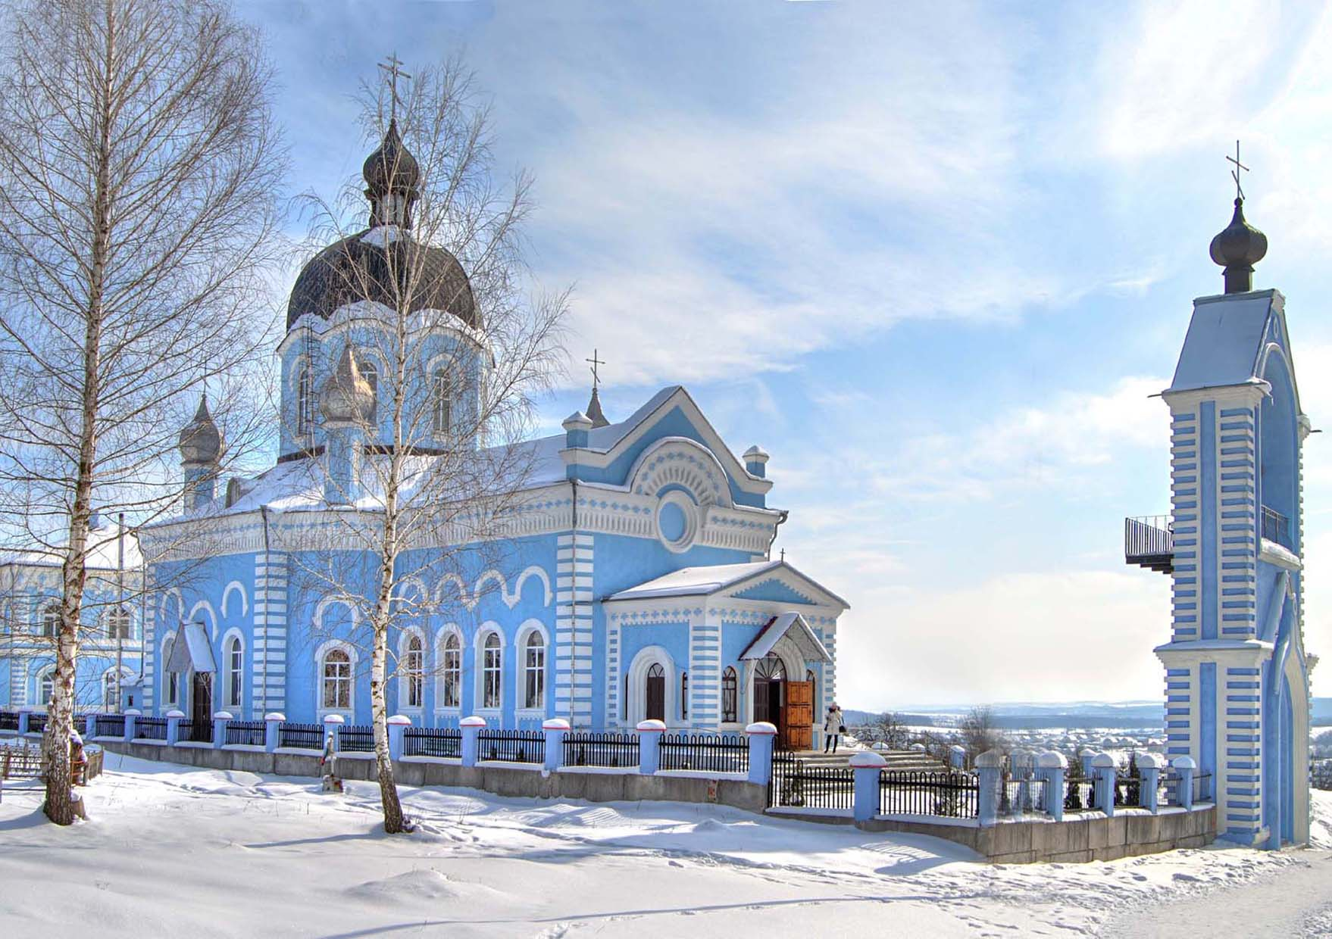
Structure and Activities of the Orthodox Parish of St. Onuphrius the Great, Ukrainian Orthodox Church
Horodok, Khmelnytskyi Region

Slide 2
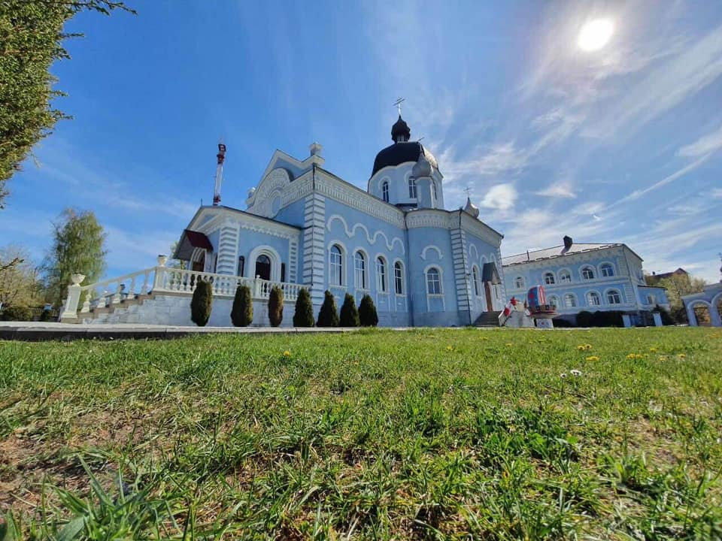
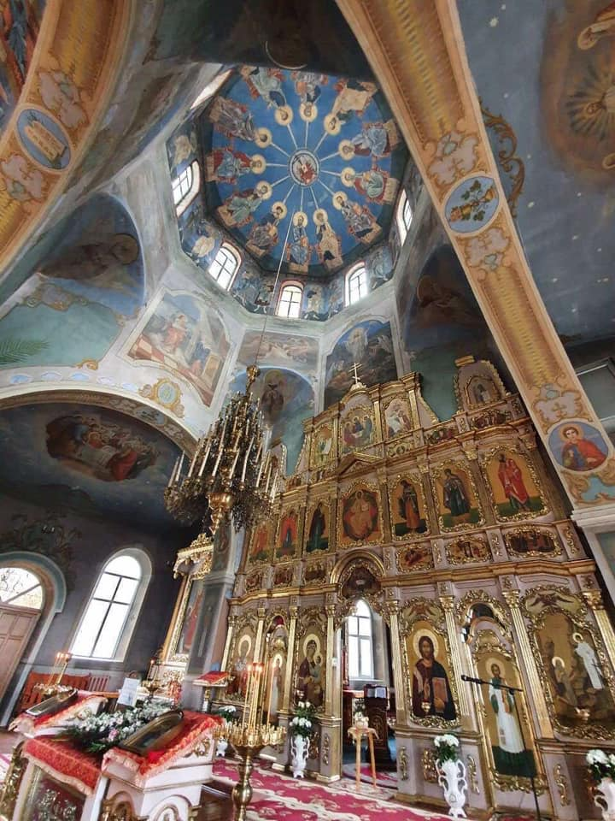
Historical Background Heading: Foundation and History
Established: 1989
The parish has been a spiritual center for Orthodox Christians in the region.
The church building reflects traditional Orthodox architecture.

Slide 3
Structure of the Parish Heading: Organizational Structure
Clergy: Parish is led by a senior priest and supported by another priest and assistants. Congregation: Active participation of local parishioners. Committees: Includes a parish council, charity groups, and educational coordinators.

Slide 4
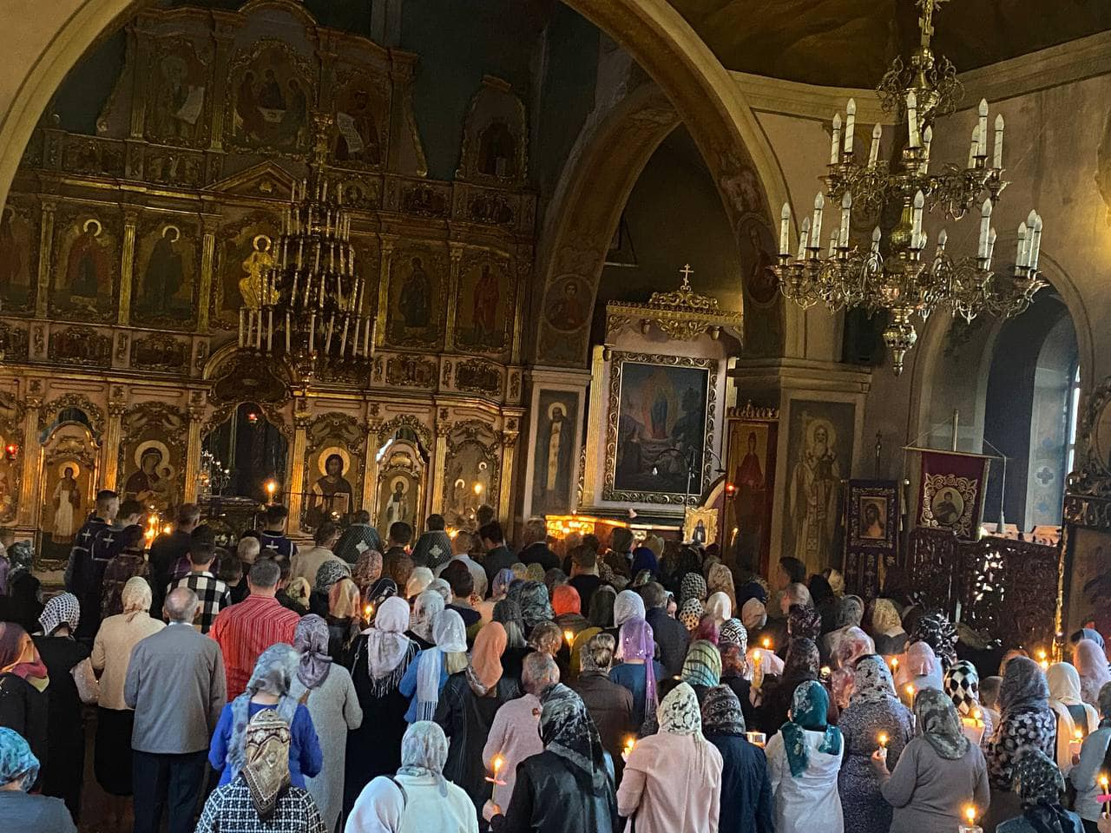
Religious Activities Heading: Liturgical and Spiritual Life
Regular Divine Liturgies, Vespers, and Matins.
Sacraments: Baptisms, Weddings, Confessions, and Unction.
Feast Day Celebrations: Especially honoring St. Onuphrius.
Special prayer services for the needs of the community and the nation.

Slide 5
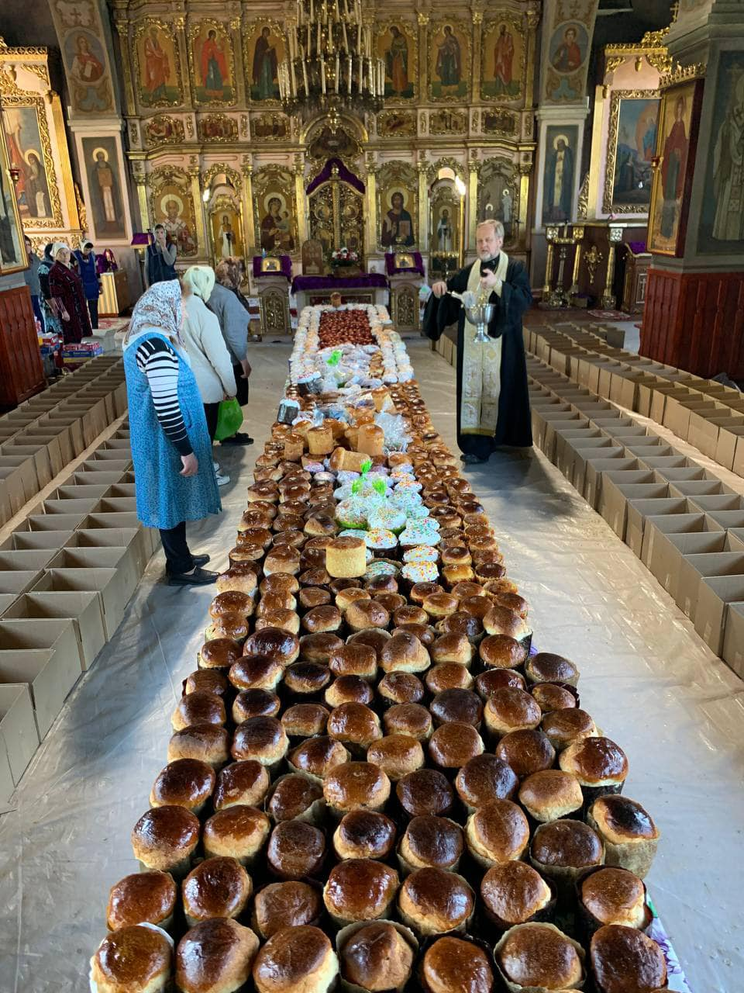
Community Engagement Heading: Beyond the Church Walls
Charity: Providing assistance to the needy, including food drives and financial support.
Education: Sunday schools for children and Bible study groups for adults.
Cultural Events: Hosting traditional Orthodox festivals and concerts.
Support During Crisis: Helping refugees and supporting those affected by war.

Slide 6
Ευχαριστώ για την προσοχή σας!

