Slide 1
THE THREE ENCOUNTERS
JESUS & THE CENTURION
JESUS AND THE BLIND MAN
JESUS & THE ADULTERESS

Slide 2
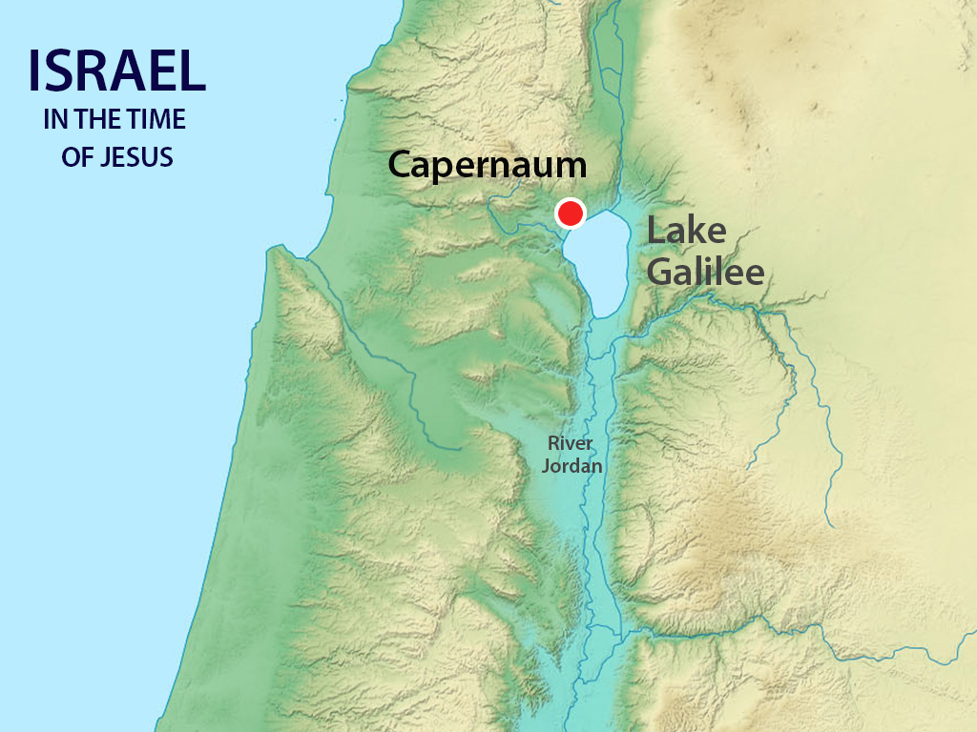

Slide 3
JESUS & THE CENTURION MATTHEW 8:5 – 13 summary
A Roman Centurion ask Jesus to heal his ailing servant
Jesus offers to visit the Centurion’s house although he is a Gentile
The Centurion declines saying “Lord, I am not worthy that you should come under my roof”
Jesus praises the Centurion before his disciples saying “I have not found such great faith, not even in Israel”
Jesus sent the Centurion home and the servant is healed that same hour
The Centurion illustrates how Jesus came to earth for everyone who is willing to believe

Slide 4
JESUS & THE CENTURION

Slide 5
Jesus & the blind man john 9:1 -38 summary
As Jesus and his disciples leave the temple they see a beggar who is blind from birth
The disciples ask Jesus if the man is blind because of his parents’ sins
Jesus responds that the man’s blindness is an occasion for the works of God to be revealed
He takes soil from the ground, mixes it with His saliva and rubs the blind man’s eyes
The blind man’s vision is restored
The Pharisees try to discredit Jesus, accusing him of performing this miracle act on the day of the Sabbath
The blind man responds that all he knows is that he was blind and now he can see
Jesus asks the blind man If he believes in the son of God
The blind man is symbolic of all of us who need transformation and illumination by Christ

Slide 6
JESUS & THE BLIND MAN

Slide 7
Jesus & the adulteress john 8:3 – 11 sUMMARY
Several scribes and Pharisees bring to Jesus a woman who is caught in adultery
They challenge Jesus to condemn her to death as is written in the law of Moses’s time
The Jewish leaders are testing Jesus, because if he forgives the adulteress he will be a lawbreaker and if he condemns her he will be inconsistent in His mercy to sinners
Jesus tells to the heated throng of people gathered around him “He who is without sin among you, let him throw the stone at her first”
with these words the crowd grudgingly throws down their stones and leave
When left alone with the woman, Jesus says to her “Woman has no one condemned you? Neither do I condemn you; go and sin no more”
This encounter demonstrates the grace and power of Christ to forgive all sinners

Slide 8
JESUS & THE ADULTERESS VIDEO

Slide 9
Vocabulary exercise i
Fill in the gaps with the correct word. Choose among a, b and c.
Feeling such a visit would be unnecessary, the Roman recognizes Jesu’s (1)______________ when he calls Him “Lord”, and tells Jesus that if He gives the (2) ______________ for the healing, he knows it will be done, just as when he gives orders to his soldiers, they are (3)_____________.
The Pharisees, eager to (4) _______________ Jesus, declare “This Man is not from God because He does not keep the Sabbath”. In other words, Jesus had performed this (5) ________________ deed on the day reserved for rest and worship of God. The beggar (6) ________________, “one thing I know, that I was blind, now I see”.
Jesus quietly answers to the (7) ______________ throng of people gathered around them, “He who is without (8) ______________ among you, let him throw a stone at her first”. With this the (9) ________________ grudgingly throws down their stones and leave. Jesus says to her, “Woman has no one condemned you? Neither do I (10) ________________ you; go and sin no more”.
1. a. offer b. authority c. disciple
2. a. praise b. decline c. order
3. a. carried out b. carried in c. carried away
4. a. discreet b. describe c. discredit
5. a. healing b. willing c. restoring
6. a. reclaims b. reserves c. responds
7. a. heating b. heat c. heated
8. a. sin b. son c. sun
9. a. grace b. crowd c. blind
10. a. compassion b. considerate c. condemn

Slide 10
Vocabulary exercise ii
Find words in the text with the following meaning:
sudden or unexpected meeting
provide a story, book with pictures or photos
restore sb to health
not Jewish
lack of merit
power or right to give orders and make others obey
follower of any leader of religious thought, art, learning etc
breaking of God’s law
rebuild, bring back into use, make well
God
complete change
copyists in former times
give judgment against
capacity for holding oneself back from punishing
to save, rescue or reclaim

