Slide 1
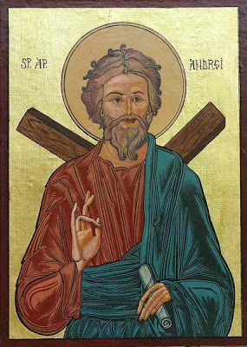
Saint andrew

Slide 2
SAINT ANDREW – THE FIRST CALLED APOSTLE
The Apostle Andrew established the first Christian church in Byzantium which later developed into our Orthodox church
Ecumenical Patriarch Bartholomew has inherited the Apostle Andrew’s legacy as his 270th direct successor

Slide 3
Saint andrew - life facts
Andrew was a follower of John the Baptist until the day Jesus arrived to be baptized by John
John told Andrew “Behold the Lamb of God” and Andrew believed that Jesus was the Saviour of whom John had foretold

Slide 4
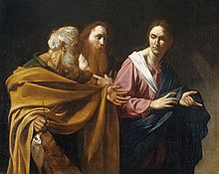
Saint andrew – life facts
Jesus invited Andrew and his brother Simon to join him
Andrew told his brother “we have found the Messiah”
In the following days Jesus found the other men who became His twelve Apostles

Slide 5
Saint andrew’s ministry
According to ecclesiastical tradition, after the Pentecost Andrew began his missionary activities on the southern shores of the Black Sea and then on to Byzantium

Slide 6
Saint andrew’s ministry
He served there from c. 36-38 A.D.
He, then, ordained the Apostle Stachys bishop
This settlement later developed into Constantinople, the cradle of Orthodoxy

Slide 7
Saint andrew’s ministry
Andrew continued his missionary work
He performed many miracles of healing in Greece and Peloponese
In Patras he was imprisoned for having converted a pagan official’s wife
He was sentenced to death by crucifixion

Slide 8
Saint andrew’s death and martyrdom
He insisted to be crucified upside down as he felt unworthy to die the Lord’s death
He the pure of heart who immediately recognized Christ and gained the crown of victory died on November 30, 62 A.D.

Slide 9
vocabulary
Ecumenical (adj.) : general, universal, οικουμενικός
Inherit (v) : receive a title or property as heir, κληρονομώ
Legacy (n): money or property given to sb in a will, κληρονομιάl
Successor: person or thing that succeeds another, διάδοχος
Behold (v): observe, see, βλέπω, παρακολουθώ
Join (v): become a member of, γίνομαι μέλος, ενώνομαι με, ακολουθώ
Ordain (v): authorize to be a priest, invest with holy orders, χειροτονώ
Settlement (n): place where people come to live and make houses, οικισμός
Cradle (n): a) small low bed sometimes mounted on rockers for a newborn child,
λίκνο, κούνια
b) place where sth is born or begins
convert (v): to persuade to accept a particular religion, belief, προσηλυτίζω
Sentence (v): say that sb is to have a certain punishment, καταδικάζω

Slide 10
Exercise i
Say whether the following sentences are True (T) or False (F).
St. Andrew is the founder of the Orthodox church.
T
Simon, Andrew’s brother, introduced him to Jesus.
F
St. Andrew established the first Christian church in a small place known as Constantinople.
F
St. Andrew was sentenced to death because he convinced a pagan woman to become a Christian.
T

Slide 11
Exercise ii
Find a word from the text for the following definitions:
receive a title or property as an heir _______________
money or property given to sb in a will _______________
person or thing that succeeds another ________________
observe, see __________________
become a member of ______________
authorize to be a priest, invest with holy orders _______________
a place where people have come to live and make houses ________________
place where sth is born or begins _______________
to persuade to accept a particular religion, belief ________________
say that sb is to have a certain punishment _________________
inherit
legacy
successor
Behold
Join
Ordain
Settlement
Cradle
Convert
sentence

Slide 12
Exercise iii
Fill in the gaps in the following text using one suitable word:
In one of his several missionary journeys (1)____ Greece, Andrew visited the city of Patras. (2) __________ his preaching and the miracles of healing performed, in the (3) _______ of Jesus, many persons (4) ______ converted to Christianity. Among those healed was Maximilla, the (5) _________ of the Roman Proconsul, Aegeates. Seeing the miracle of (6) ____________, Stratoklis, the highly intellectual brother of the Proconsul, also (7) ____________ a Christian, and Andrew enthroned (8) __________ as the first Bishop of Patras.
1. a. at b. of c. to
2. a. through b. because c. when
3. a. title b. face c. name
4. a. was b. were c. has
5. a. wife b. husband c. aunt
6. a. healing b. heal c. healed
7. a. become b. became c. becoming
8. a. himself b. his c. him

Slide 13
links
https://youtu.be/HOv5fWJtXV4
https://youtu.be/jQjUBKAdR6I
https://en.wikipedia.org/wiki/Andrew_the_Apostle

