Slide 1
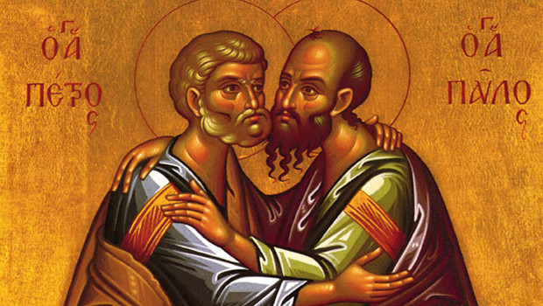
SAINT PETER & SAINT PAUL

Slide 2
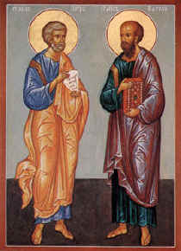
PILLARS OF THE CHURCH
On June 29th feasts of Saint Peter and Saint Paul
Lived 1st century A.D.
Both helped to spread the word of God
Both died in martyrdom in Rome circa 67 A.D.

Slide 3
SAINT PETER
Simon first met Jesus through his brother Andrew
Both brothers were fishermen at the Sea of Galilea
When they met Jesus they both gave up their work and became Jesus’s disciples
Jesus gave Simon a new name, Peter (Petros) meaning the rock
Peter was with Jesus throughout his ministry
Peter denied knowing Jesus upon His arrest but later repented
After Christ’s Resurrection and Ascension and the grace of Pentecost, Peter helped foster the Christian community in Jerusalem

Slide 4
SAINT PETER
When arrested by the Jewish authorities, an angel of the Lord freed him
He journeyed throughout Asia Minor, Syria, Palestine and Italy preaching about Christ
He performed many miracles and resurrections
He established the first church in Antioch and became its first bishop
In Rome converted many to the faith
When persecutions started in Rome he tried to leave the city but on the way he saw Jesus heading in the opposite direction so he returned to Rome
He was arrested and condemned to be crucified
He asked to be crucified upside down as he felt unworthy of the same punishment as his Lord

Slide 5
SAINT PAUL
Saul was a devout Jewish from Tarsus, Syria
Christianity for him was a threat to Judaism and he was determined to eradicate it
On his way to Damascus he was struck by a vision of heavenly light and Jesus appeared in front of him
Saul was blinded by this light but after his encounter with Jesus he believed in Him and went to Damascus waiting for Christ to tell him what to do
Ananias, a devout Christian, healed him and baptized him so that he could receive the Holy Spirit

Slide 6
SAINT PAUL
He changed his name to Paul and started to preach to the people about Jesus
He left Damascus when the Jews plotted to kill him
In Jerusalem he tried to join the Apostles but they were afraid of him as they knew him as a keen persecutor of Christians
Barnabas believed in him and brought him to the Apostles
Barnabas and Paul went on missionary travels together throughout Syria, Asia Minor, Cyprus and Greece

Slide 7
SAINT PAUL
He also travelled to Ephesus, Corinth, Athens, Thrace, Crete, Malta, Sicily and Rome
He is considered the greatest Apostolic missionary and is often referred as the Apostle to the Gentiles
Hallmarks of his ministry were his great courage, stamina and fierce intelligence
He was a brilliant orator and writer
His letters or epistles make up almost half of the New Testament
In Rome Paul was arrested and beheaded in 67 A.D.

Slide 8
SAINT PETER’S CRUCIFIXION

Slide 9
SAINT PAUL’S MARTYRDOM

Slide 10
VIDEOS AND LINKS
https://youtu.be/LQoxL1AJYdw
https://youtu.be/O9hQwDR3ZjI

Slide 11
VOCABULARY I – EXERCISE 1
Choose the correct answer for the words below:
1. dedication a. αφοσίωση b. επιμέλεια
2. ministry a. διακονία b. Ιερατείο
3. inspiration a. αγιότητα b. Έμπνευση
4. foretold a. προφήτευσε b. Προσκάλεσε
5. converted a. Καταδίωξε b. προσηλύτισε
6. devout a. θρήσκος b. άθρησκος
7. persecute a. καταδιώκω b. ακολουθώ
8. missionary a. εκστρατευτικός b. Ιεραποστολικός
9. stamina a. σθένος b. Ανοχή
10. faith a. φήμη b. πίστη

Slide 12
Match the words with their Greek translation.
celebrate ____ a. ευλογώ, ευλογία
feast ____ b. θαύμα
sustenance ____ c. κηρύττω
minister ____ d. μετανοώ
commitment ____ e. τιμωρία
bless ____ f. γιορτάζω
prevail ____ g. κύριο χαρακτηριστικό
repent ____ h. διατροφή
resurrection ____ i. αποκεφαλισμένος
ascension ____ j. υποχρέωση
miracle ____ k. ανάσταση
crucified ____ l. διαθήκη
punishment ____ m. προσφέρω, υπηρετώ
vision ____ n. κυριαρχώ
arise ____ o. όραμα
preach ____ p. ρήτορας
hallmark ____ q. γιορτή
orator ____ r. σταυρωμένος
testament ____ s. ανάληψη
beheaded ____ t. εγείρομαι

Slide 13
A little bit of Grammar – Present Simple
http://www.perfect-english-grammar.com/support-files/present_simple_form.pdf
http://www.perfect-english-grammar.com/support-files/present_simple_mixed_exercise_1_be_and_other_verbs.pdf
https://www.slideshare.net/tebaestruba/present-simple-explanation-exercises
http://www.mysterycove.ch/game/files/resources/grammar/grammar_present_continuous.pdf
https://learnenglishteens.britishcouncil.org/sites/teens/files/gs_pres_cont_-_exercises.pdf
http://www.eslgamesworld.com/members/games/grammar/index.html

